Slide 1
SIMPLE MOTION DETECTION IN VIDEO SEQUENCES
Filip Milić
Tomislav Grdenić
Barthélémy Marsault
Florian Gigot
Gaëtan Jagorel
A Project for the Digital Image Processing and Analysis Course
2019./2020.

Slide 2

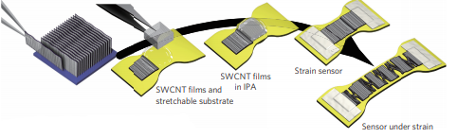
ON MOTION DETECTION
A stretchable carbon nanotube strain sensor for human-motion detection
You Only Look Once (YOLO)

Slide 3
PROJECT GOALS
Detect movement of objects in video sequences (no object classification)
Draw a bounding box around the moving object as long as the object moves
Presumption of a static camera (IE, security cameras)
Learning-free
Using only information present on the footage itself (no additional sensor info)
Real-time

Slide 4
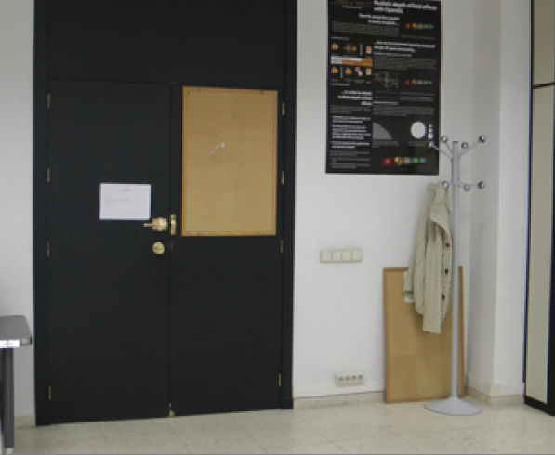
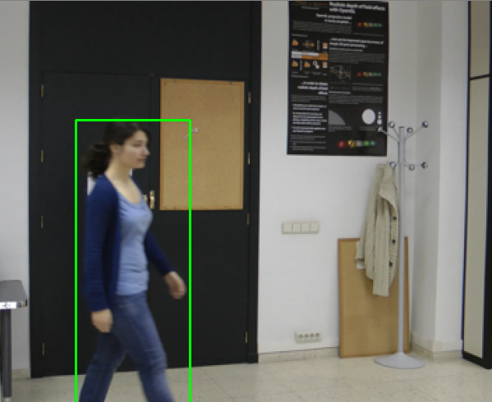
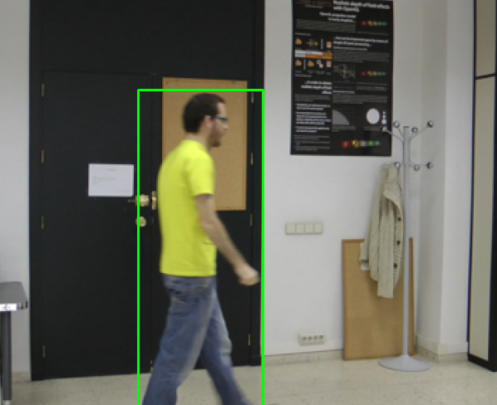
PROJECT GOALS
An example of our ideal solution

Slide 5
THE TWO METHODS
BACKGROUND SUBTRACTION
OPTICAL FLOW

Slide 6
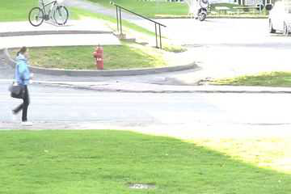
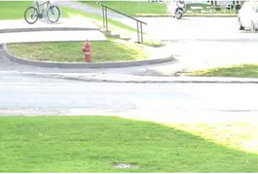

THE BACKGROUND SUBTRACTION MODEL
-
=
VIDEO FRAME
BACKGROUND
FOREGROUND

Slide 7
THE BACKGROUND SUBTRACTION MODEL
-
=
VIDEO FRAME
BACKGROUND
FOREGROUND

Slide 8
THE BACKGROUND SUBTRACTION MODEL
Everything in the foreground is a moving object.
FOREGROUND

Slide 9

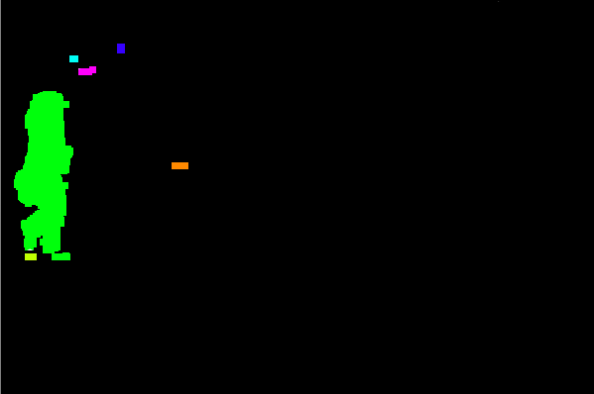
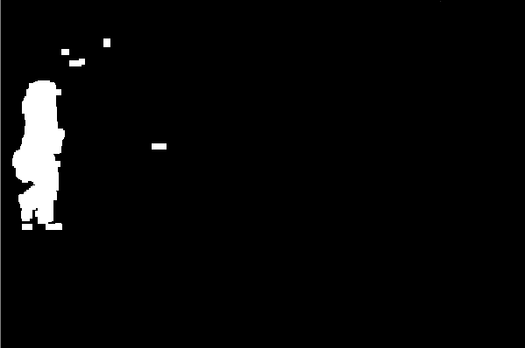
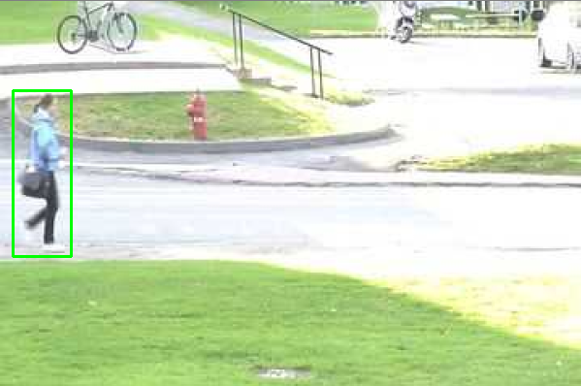

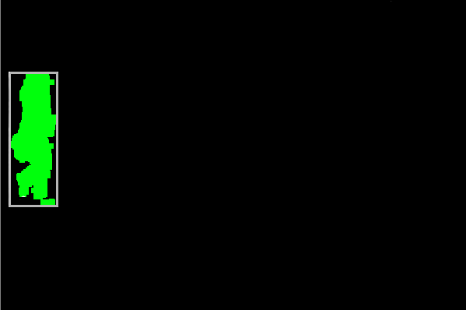
THE BACKGROUND SUBTRACTION MODEL
Remove all pixels values in the foreground below a given value
Dilate the image
Find closed contours (objects) in the foreground
Ignore all contours below a specified area threshold
Draw a bounding box on the original frame, on the positions of the remaining contours
FOREGROUND

Slide 10
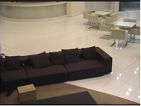
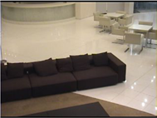
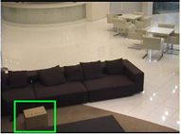

THE PROBLEM OF BACKGROUND SUBTRACTION
Everything in the foreground is a moving object.
…Everything in the foreground is a moving object?
-
=

Slide 11
THE PROBLEM OF BACKGROUND SUBTRACTION
Everything in the foreground is a moving object.
…Everything in the foreground is a moving object?
-
=

Slide 12
THE PROBLEM OF BACKGROUND SUBTRACTION
The reference background image needs to adapt to changes.
How to detect changes?
How do we update the background image?
How to know when to update the image?

Slide 13
ADAPTING TO BACKGROUND CHANGES
Solution proposed by Zivkovic Z. and van fer Heijden F.
A k-NN like classifier that keeps N past frames as references
For each pixel of the new frame, determines whether it’s part of the background (if it isn’t, it’s automatically classified as a foreground pixel)
Stores the new frame and determines, for each pixel, whether or not it should be used in classifying future frames
No longer a matter of simple subtraction, but classification

Slide 14
THE k-NN-LIKE SOLUTION
k-NN-like Classifier

Slide 15
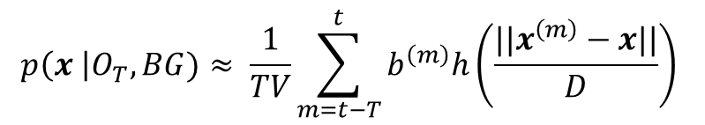
THE k-NN-LIKE SOLUTION (CLASSIFICATION)
R
G
B
$$p\left(x \right|O_{T}, BG)≈ \frac{1}{TV}\sum_{m=t−T}^{t}{b^{\left(m\right)}h\left(\frac{||x^{\left(m\right)}−x||}{D}\right)}$$

Slide 16
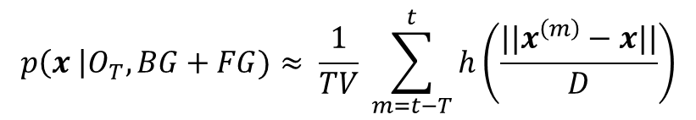
THE k-NN-LIKE SOLUTION (STORING)
R
G
B
$$p\left(x \right|O_{T}, BG+FG)≈ \frac{1}{TV} \sum_{m=t−T}^{t}{h\left(\frac{||x^{\left(m\right)}−x||}{D}\right)}$$

Slide 17
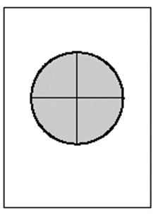
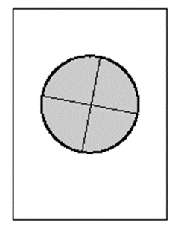
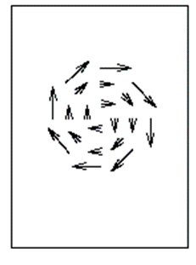
THE OPTICAL FLOW MODEL
Based on calculating a frame’s dense optical flow (Farneback)
Calculating the magnitudes for each of the found vectors
Areas with high vector magnitudes will equate to movement
Detection of contours and bounding box drawing similar to the background subtraction model

Slide 18
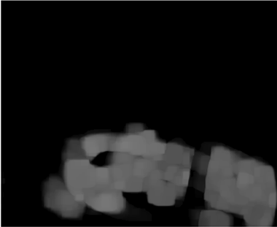
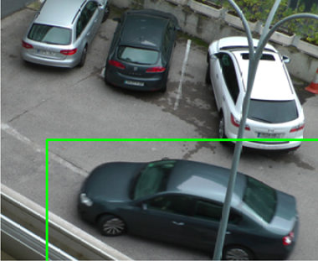
THE OPTICAL FLOW MODEL

Slide 19
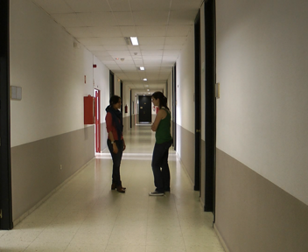
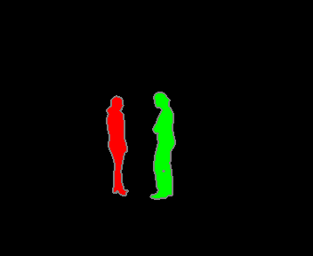
THE LASIESTA DATASET

Slide 20


IMPLEMENTATION

Slide 21
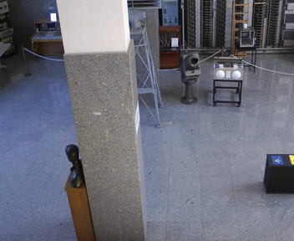
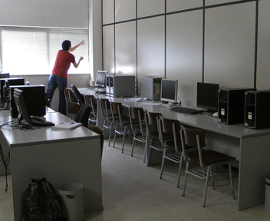
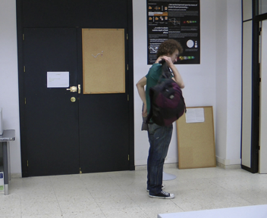
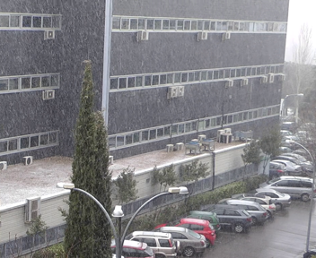
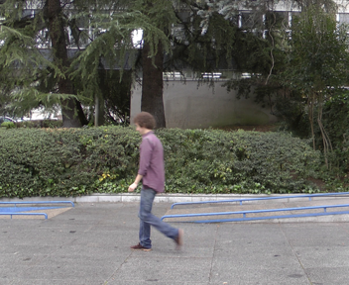
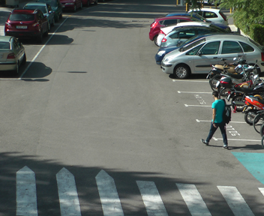
THE LASIESTA DATASET

Slide 22



TESTING METHODOLOGY

Slide 23
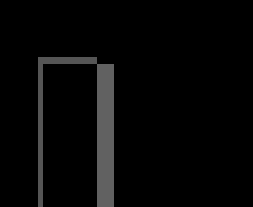

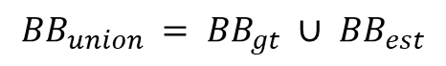



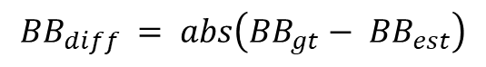

TESTING METHODOLOGY
$${BB}_{diff} = abs\left({BB}_{gt}− {BB}_{est}\right)$$
$$−$$
$$=$$
$${BB}_{union} = {BB}_{gt} ∪ {BB}_{est}$$
$$∪$$
$$=$$

Slide 24
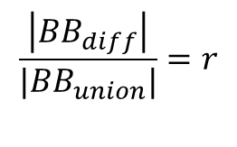

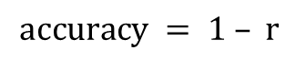
TESTING METHODOLOGY
$$/$$
$$\frac{\left|{BB}_{diff}\right|}{{|BB}_{union}|}=r$$
$$accuracy = 1 – r$$

Slide 25
RESULTS
 | Accuracy | Relative Accuracy
Background Subtraction | 0.7350135556697914 | 0.5734853744366488
Optical Flow | 0.6287926276670289 | 0.424651775566147

Slide 26
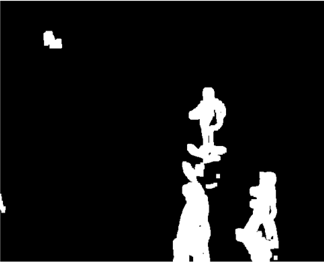
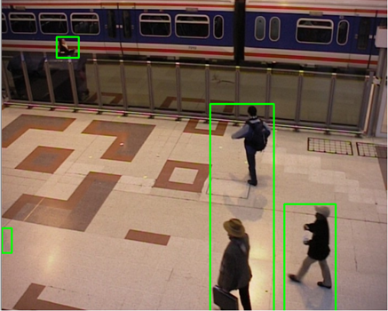
OBSERVATIONS

Slide 27
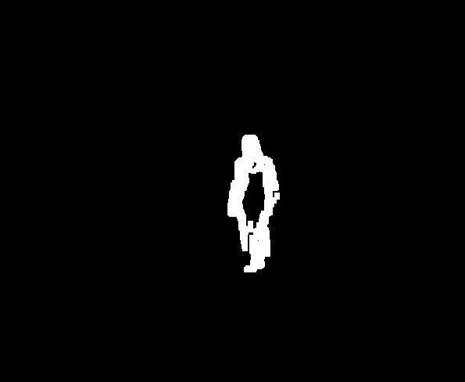
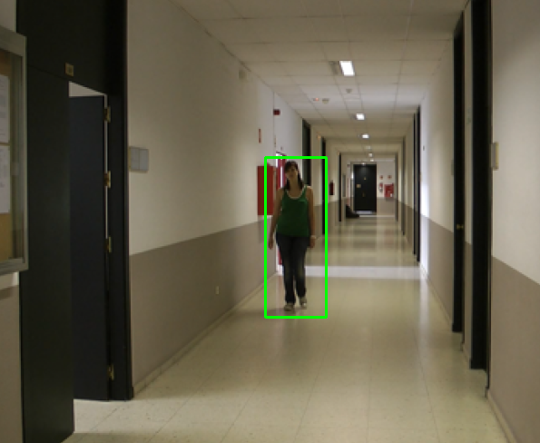
OBSERVATIONS

Slide 28
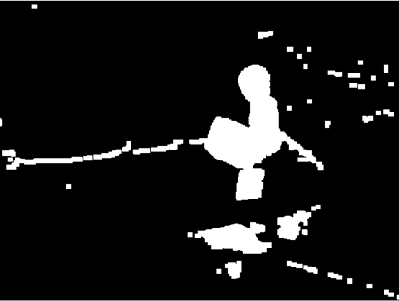
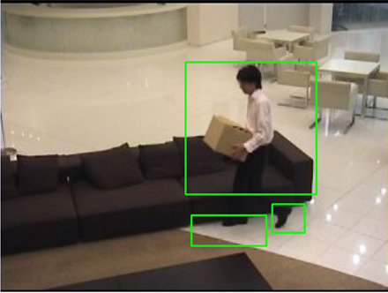
OBSERVATIONS

Slide 29
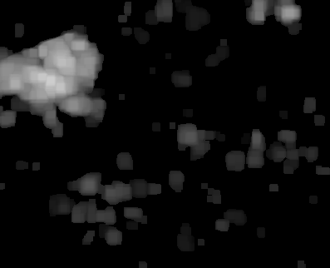
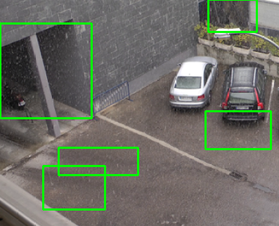
OBSERVATIONS

Slide 30
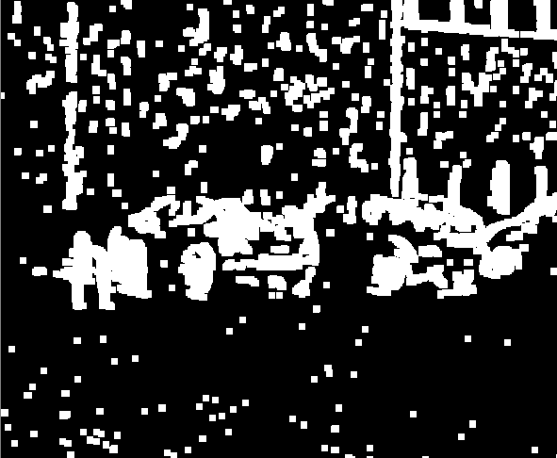
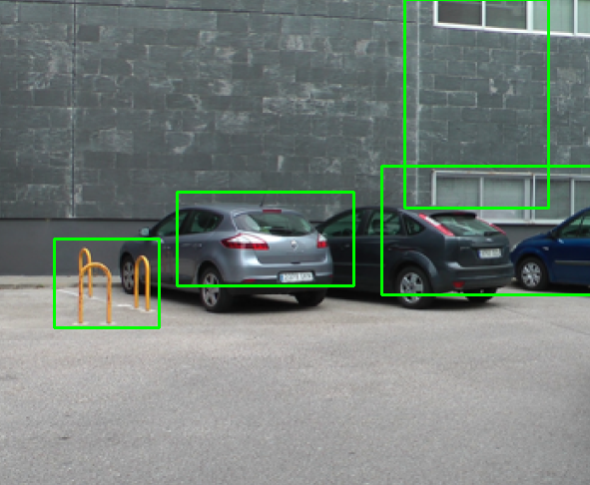

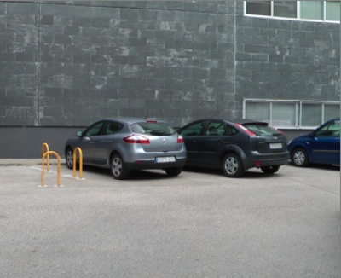
OBSERVATIONS

Slide 31
THANK YOU FOR LISTENING

